Slide 1
Battle of Neighbourhoods.V3

Slide 2

Problem Description
The customer that received The Battle of Neighbourhood.V1 was not satisfied with the result
Why?
The model didn’t not consider the quality of the venues
The model only considered the quantities of venues
Many venues that are considered common has zero likes
A ghetto neighbourhood is similar to luxury neighbourhood if it has the same common venues
The model didn’t summaries where should our customer go at the end. Just gave some data
How could be correct?

Slide 3

Needed Data
There should some way to consider the likes or rating of the venue in the final results
There should be a way to access the Venue details and catogories
Checking the APIs of Foursquare show that explore and likes APIs are good to start with
Unfortunately, rating is considered premium API thus only likes is uses
This Photo by Unknown Author is licensed under CC BY-NC-ND

Slide 4
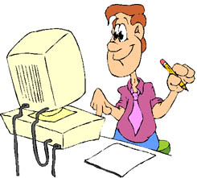
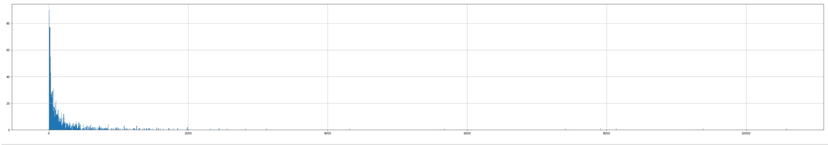
Methodology
Fetching the number of likes for each venue using Foursquare APIs
The distribution of likes are examined using histogram as shown in the plot
The plot support our assumption that Foursquare explore is returning so many venues that have no likes.
The plot shows that most of the venus have zero likes. Thus we apply some rules to consider the quality of the venue
This Photo by Unknown Author is licensed under CC BY-SA-NC

Slide 5
Methodology - Rules
If the venue has less than 25 or equal to likes then this venue is equivelant to one venue
If the venue has more than 25 like less than or equal to 50 then this venue is equivelant to two venue of same category
If the venue has more than 50 like less than or equalt to 100 then this venue is equivelant to three venue of same category
If the venue has more than 100 likes less than or equalt to 200 then this venue is equivelant to five venue of same category
If the venue has more than 200 likes less than or equalt to 300 then this venue is equivelant to 7 venue of same category
If the venue has more than 300 likes less than or equalt to 500 then this venue is equivelant to ten venue of same category
This Photo by Unknown Author is licensed under CC BY-SA-NC

Slide 6
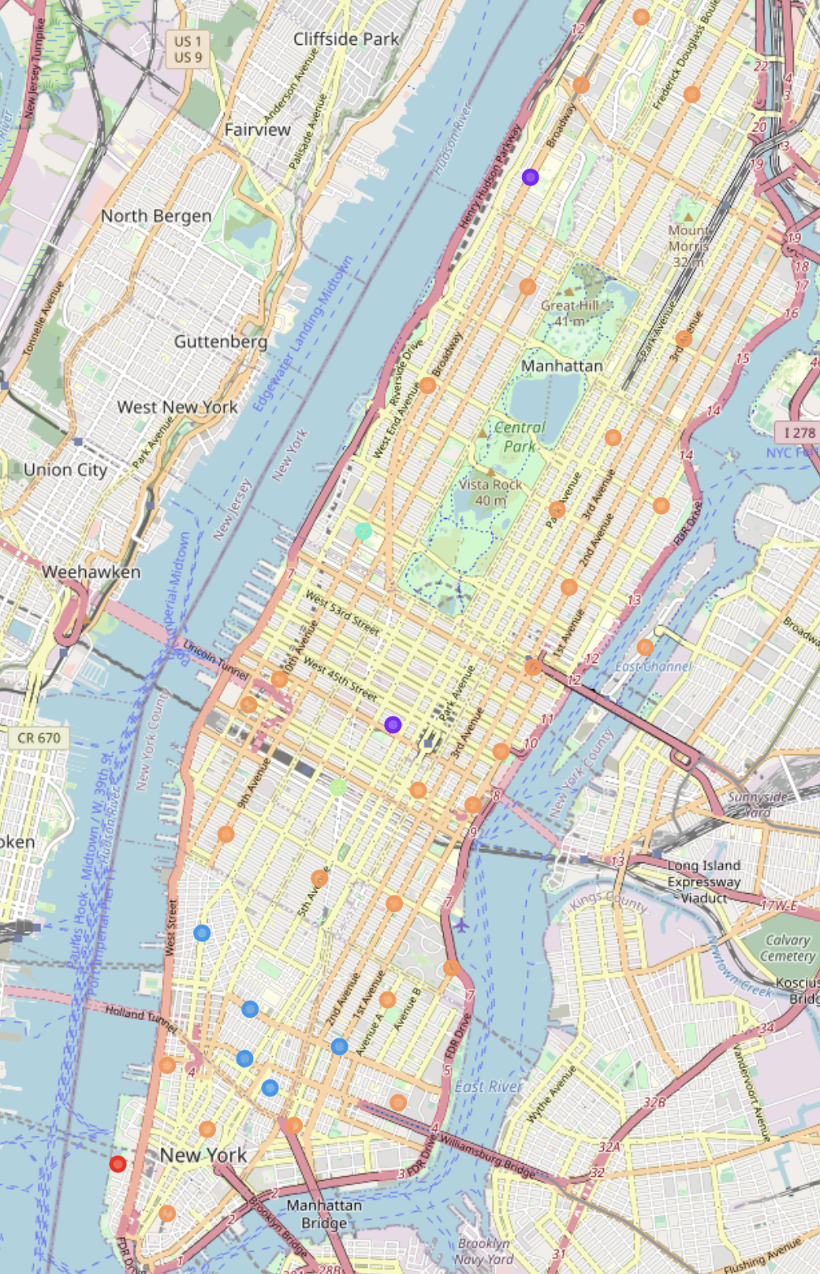
Results
We got new results that are compareable to V1, however we think that V3 has more sound results

Slide 7
Discussion
We were able to cluster the neighbourhood to distinctive unique one and also produce suggestion that fit the type of the customer
For ordinary customers (the common one) who would like to have regular neighborhoods with sufficient varieties of restaurants and activities we recommend one of the following neighborhoods (the customer can choose which suite the best) (next slide)

Slide 8
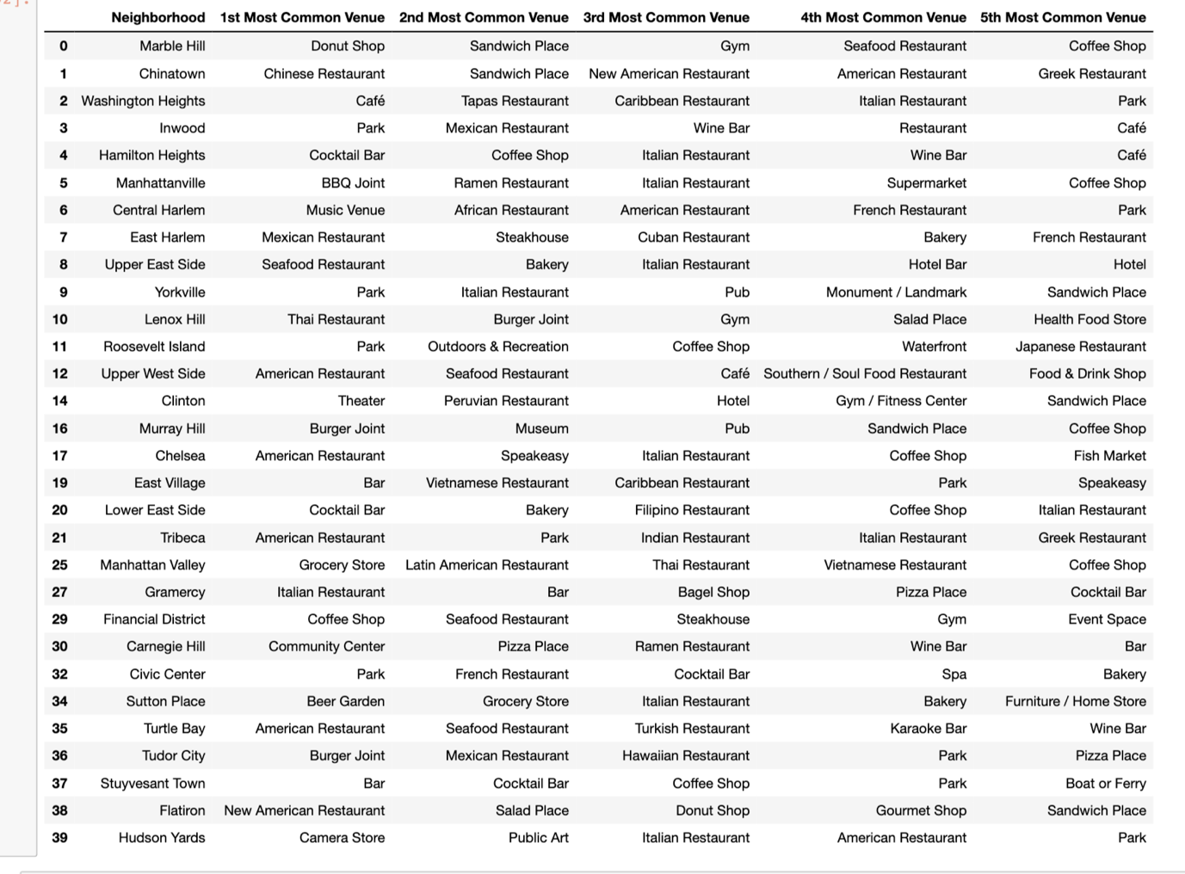
Discussion

Slide 9

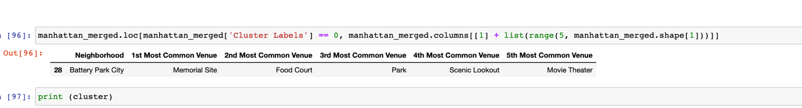
Discussion
This Photo by Unknown Author is licensed under CC BY-SA
For those who care the most about the atmosphere of the neighborhood with beautiful sceneries ,memorial sites and park there are not much options. Battery Park City is the best fit. The most quality venues has changed from gym, coffe shop , hotel and plaza to the venues the people appreciate the most in this neighborhood .

Slide 10

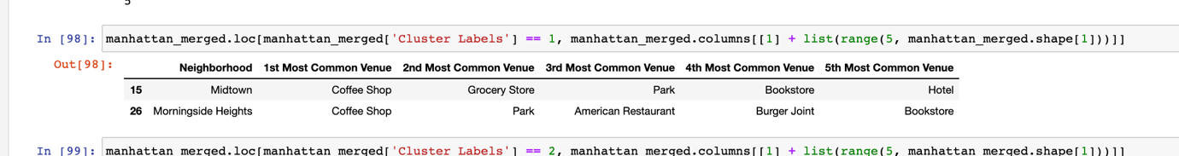
Discussion
Our customer care the most about parks, books and coffee shops? Midtown and Morningsight Height are the best candidates for such customers

Slide 11
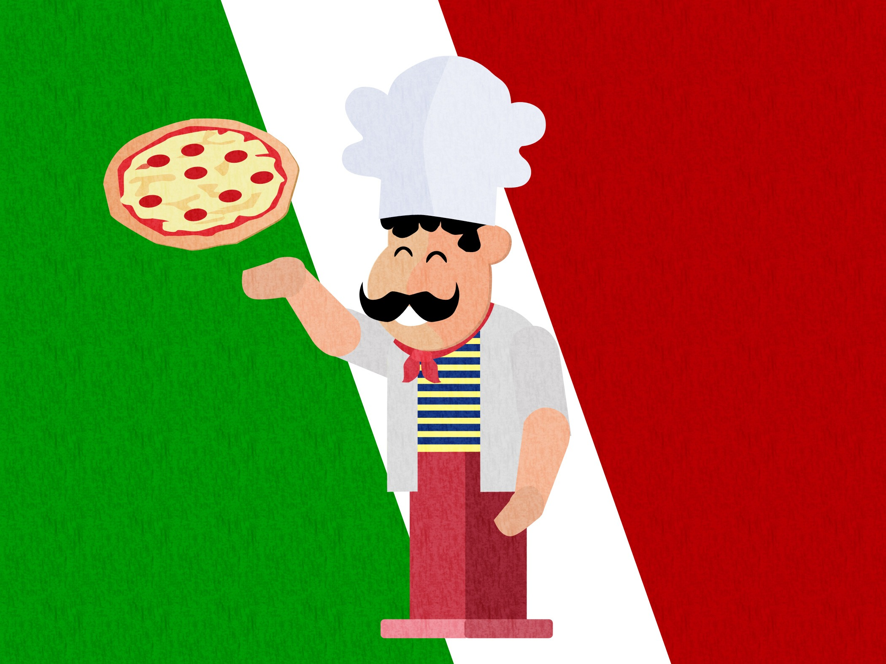
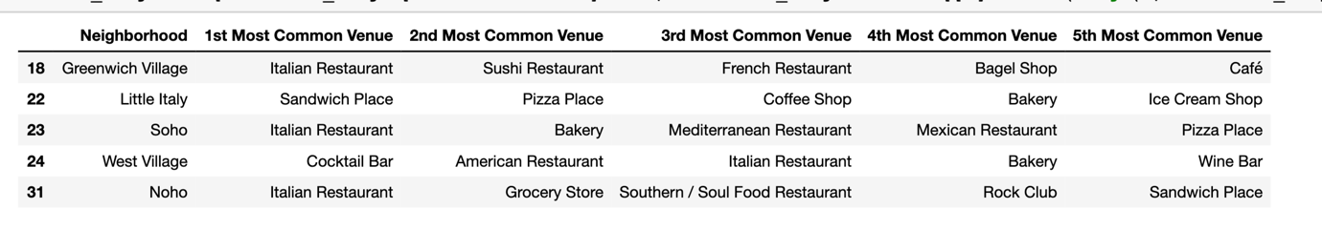
Discussion
The Mediterranean touches are visible strongly in particular neighborhoods where every neighborhood of these has Italy/Italian as its best venue

Slide 12
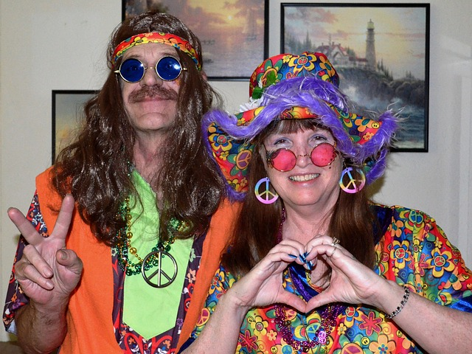

Discussion
The hippies, indies artists and designers have their fit neighborhoods as well. For those people we recommend Lincoln Square

Slide 13
Conclusion
An updated version of the battle of the neighborhoods was made to consider the quality of the venues in clustering the neighborhoods in addition to the quantity. The results show really promising and sound logic. The logic can be updated further based on our customers input. The rules that made the foundation for this analysis can be tailored in addition to the methodology.

